Slide 1

Mining Data Streams
Presenter: Jay Kumar
Date: 2021-11-15
School of Computer Science and Engineering, University of Electronic Science & Technology of China

Slide 2
Outline
Overview of Research Work
Evolving Text Streams Mining
Research background
Online Semantic-enhanced Dirichlet Model
Online Graphical Model of Evolving Text Streams
Blockchain-Federated-Learning Framework for COVID-19 detection
Conclusion

Slide 3
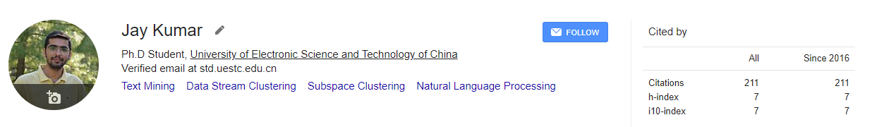
Research Work Overview
Masters Research Work
Fake Review Detection Using Behavioral and Contextual Features
https://arxiv.org/abs/2003.00807
Ph.D. Research Works
Online Semantic-enhanced Dirichlet Model [published]
Online Graphical Model of Evolving Text Streams [published]
Online Dirichlet Model with Episodic Inference [under review]
Semi-supervised Learning for Multi-label Text Streams [not submitted]
Collaborative Works
Covid-19 detection using CT imaging
Sindhi Natural Language Processing

Slide 4
Evolving Text Streams Mining

Slide 5



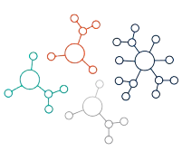



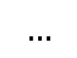

Text Stream Mining
A huge unstructured short text data is generated every day
E.g., Facebook , Tweeter, Google news
Such infinite sequential arrival of text documents is referred as text stream
Mining such text stream is important due to system enhancement and applications. E.g., News recommendation, Advertisement, Hot-topic detection, Rumor Detection
Decision making based on extracted patterns
Sources
$$∞$$
$$…$$
Knowledge
Data Stream
Pattern

Slide 6









Challenges
Mining Text Stream data is challenging due to its unique properties
Designing Algorithm for Mining
Volume
Velocity
Concept Evolution
High Dimensionality
Value
Bulk amount
Many sources
Arriving speed
Data volume is different per day
Distributional changes
Datatype changes
Lots of features to process
Objective depends on Domain
Adaptability
Availability
Limited Memory
Re-usability
Rapid detect of data evolution
Remove old concepts
Able to predict anytime
Less time to update the model
Able to store current concepts
Memory constraint for huge volume
Applicability for many domains

Slide 7
1
An Online Semantic-enhanced Dirichlet Model for
Short Text Stream Clustering
in Annual Meeting of the Association for Computational Linguistics, 2020

Slide 8


Introduction
The task of grouping similar documents is referred as clustering
Clustering short text for stream environment is difficult due to:
Topic Evolution
the number of topics change over time
every day number of active events varies
Non-stationary feature size
new documents may contain some new words
documents of new topics may represented by new terms
Old terms may not be useful for new topics
15th Jan
16th Jan
15th Jan
16th Jan

Slide 9


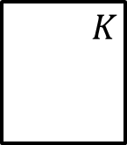

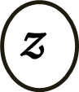
State-of-the-art Models
Previous algorithms for such clustering task follow the generative model referred as topic modeling
These generative models are transformed from stochastic process to model the random generation of documents from known vocabulary
The LDA is initial topic model which works on static environment to construct topic-document matrix
θ
$$𝒟$$
$$𝔃$$
Document-Topic distribution
Topic-word distribution
Dirichlet Parameter
$$w$$
$$K$$
$$𝒩$$
β

Slide 10
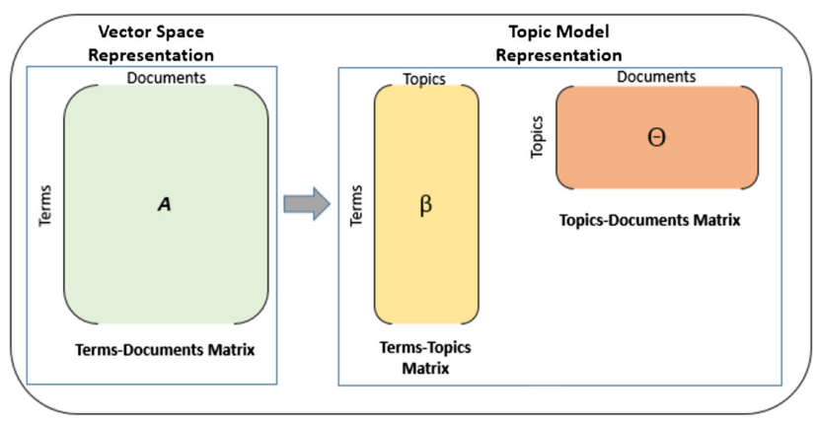


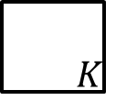


State-of-the-art Models
Latent Dirichlet Allocation (LDA)
No temporal dependency between document
Static features
Static number of topics
Model iterate whole corpus multiple time
Graphical Representation
Probability based matrix construction
θ
$$𝒟$$
$$𝔃$$
$$w$$
$$K$$
$$𝒩$$
β

Slide 11
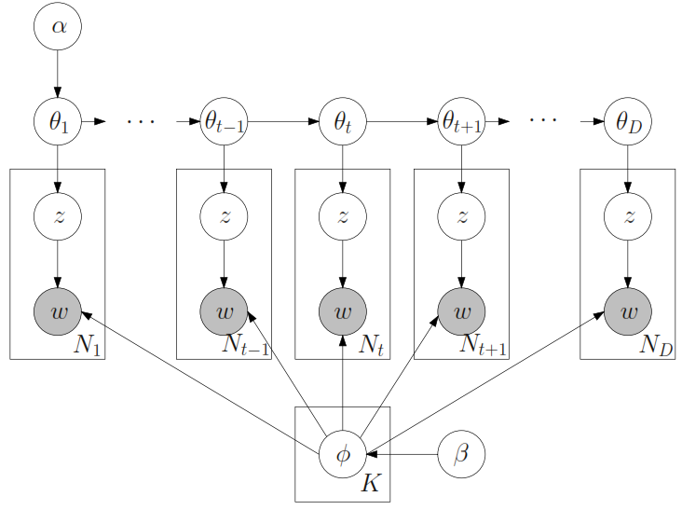
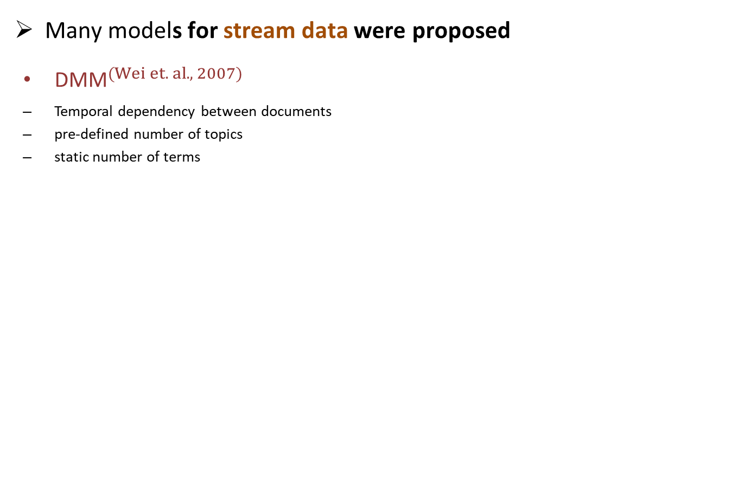

State-of-the-art Models
Many models for stream data were proposed
${\text{DMM}}^{(Wei et. al. , 2007)}$
Temporal dependency between documents
pre-defined number of topics
static number of terms
$$DMM$$
Wei, J. Sun, X. Wang. Dynamic mixture models for multiple time-series[C]. IJCAI, 2007

Slide 12
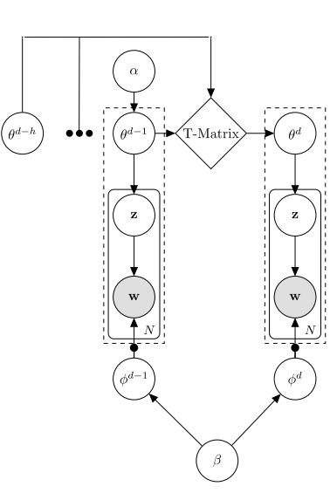
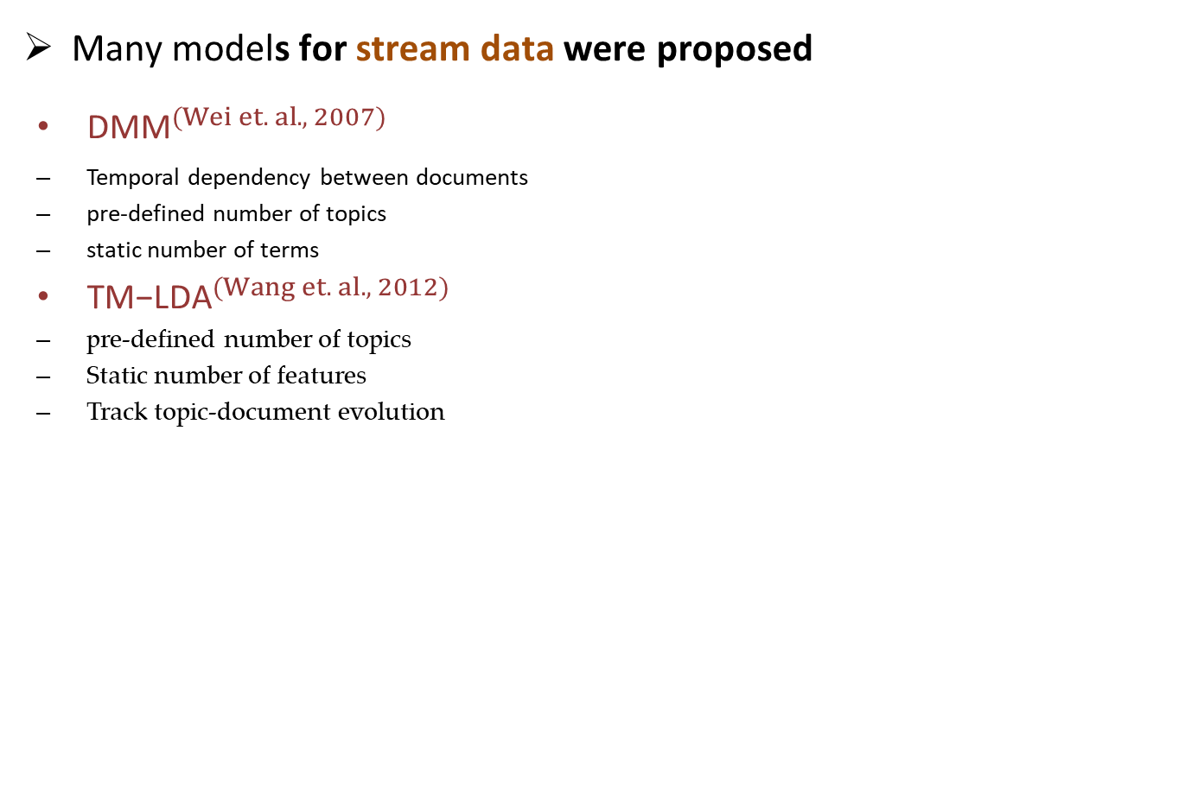

State-of-the-art Models
Many models for stream data were proposed
${\text{DMM}}^{(Wei et. al. , 2007)}$
Temporal dependency between documents
pre-defined number of topics
static number of terms
${\text{T}\text{M}\text{−}\text{LDA}}^{(Wang et. al. , 2012)}$
pre-defined number of topics
Static number of features
Track topic-document evolution
$$TM−LDA$$
Wang, E. Agichtein, M. Benzi. TM-LDA: efﬁcient online modeling of latent topic transitions in social media[C]. KDD

Slide 13
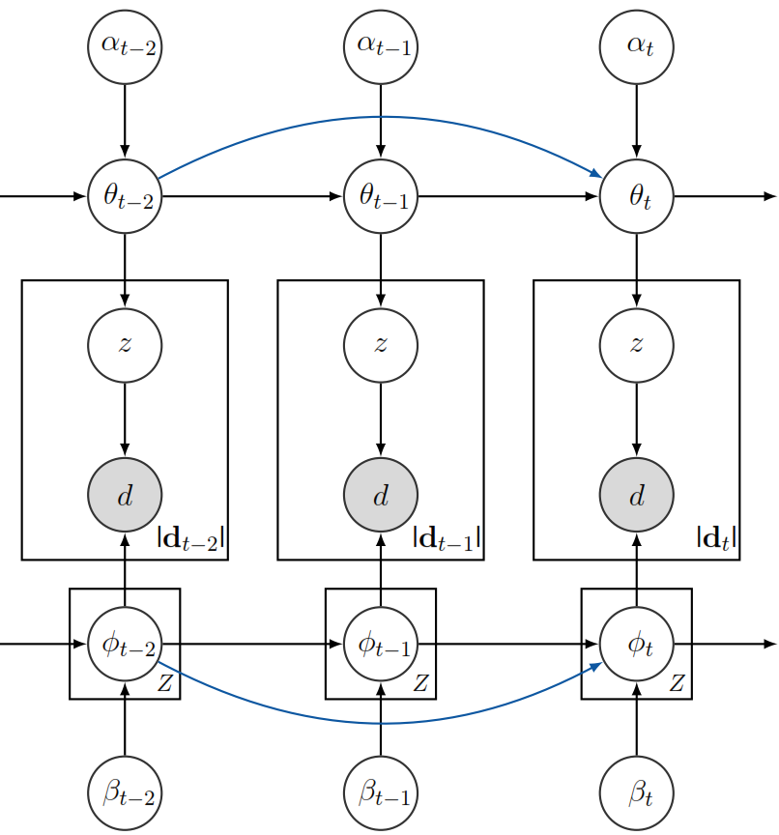
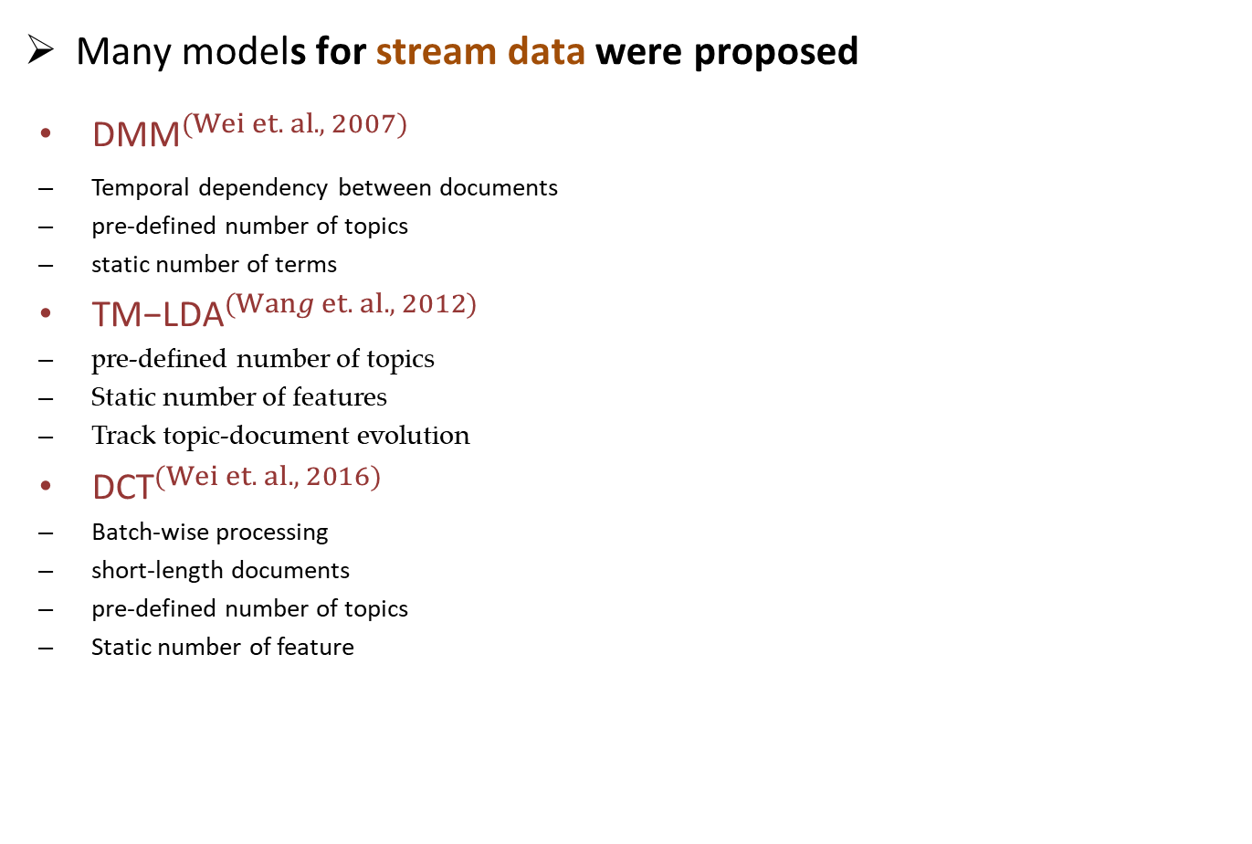

State-of-the-art Models
Many models for stream data were proposed
${\text{DMM}}^{(Wei et. al. , 2007)}$
Temporal dependency between documents
pre-defined number of topics
static number of terms
${\text{T}\text{M}\text{−}\text{LDA}}^{(Wang et. al. , 2012)}$
pre-defined number of topics
Static number of features
Track topic-document evolution
${\text{DCT}}^{(Wei et. al. , 2016)}$
Batch-wise processing
short-length documents
pre-defined number of topics
Static number of feature
$$DCT$$
Dynamic clustering of streaming short documents[C]. SIGKDD, 2016

Slide 14
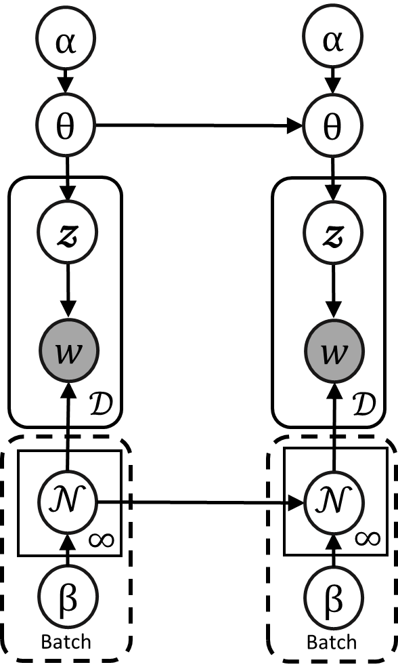
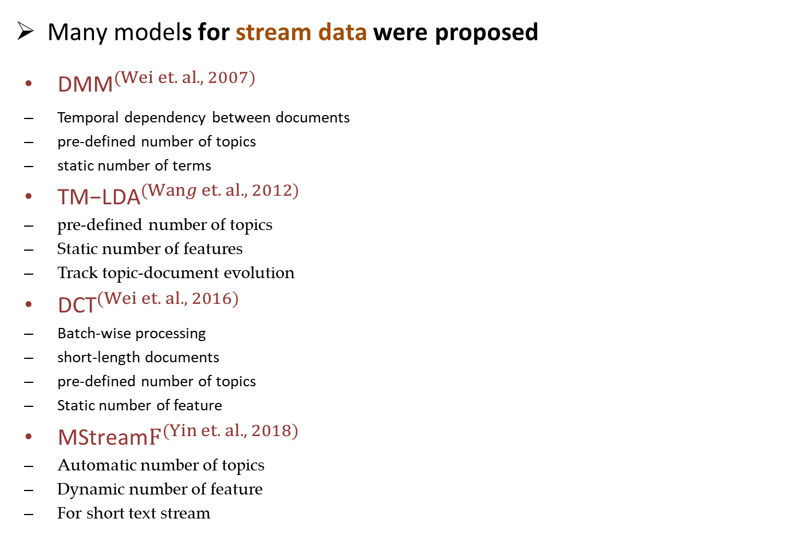

State-of-the-art Models
Many models for stream data were proposed
${\text{DMM}}^{(Wei et. al. , 2007)}$
Temporal dependency between documents
pre-defined number of topics
static number of terms
${\text{T}\text{M}\text{−}\text{LDA}}^{(Wang et. al. , 2012)}$
pre-defined number of topics
Static number of features
Track topic-document evolution
${\text{DCT}}^{(Wei et. al. , 2016)}$
Batch-wise processing
short-length documents
pre-defined number of topics
Static number of feature
${\text{MStream}F}^{(Yin et. al. , 2018)}$
Automatic number of topics
Dynamic number of feature
For short text stream
$$MStreamF$$
Model-based clustering of short text streams[C]. SIGKDD, 2018

Slide 15



State-of-the-art Models
Many models for stream data were proposed
${\text{DMM}}^{(Wei et. al. , 2007)}$
Temporal dependency between documents
pre-defined number of topics
static number of terms
${\text{T}\text{M}\text{−}\text{LDA}}^{(Wang et. al. , 2012)}$
pre-defined number of topics
Static number of features
Track topic-document evolution
${\text{DCT}}^{(Wei et. al. , 2016)}$
Batch-wise processing
short-length documents
pre-defined number of topics
Static number of feature
${\text{MStream}F}^{(Yin et. al. , 2018)}$
Automatic number of topics
Dynamic number of feature
For short text stream
$$p(z_{d}=z |\vec{z},α)$$
prior probability
$$p(d | z_{d}=z, {\vec{d}}_{z→d}, β)$$
Topic document similarity

Slide 16
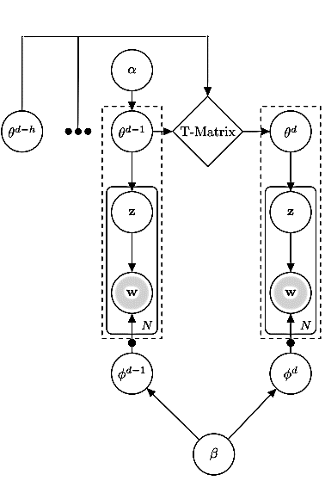
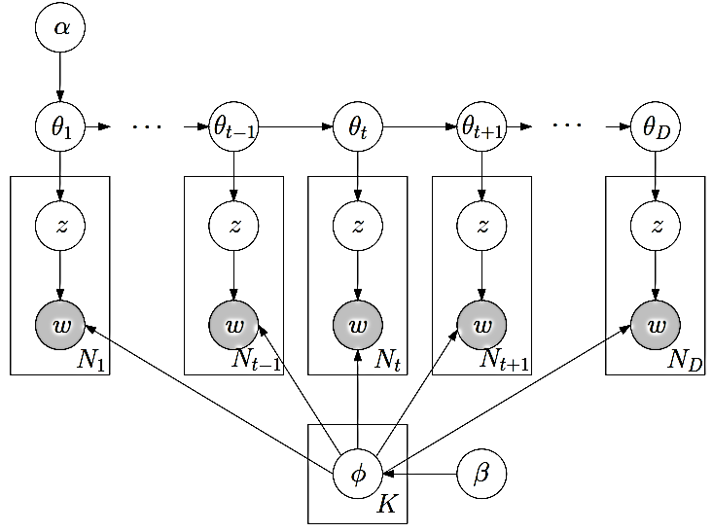
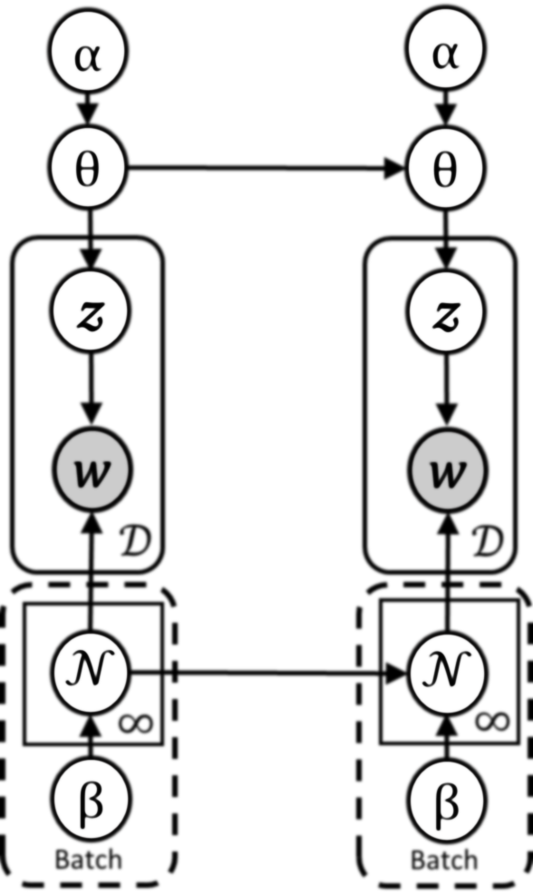
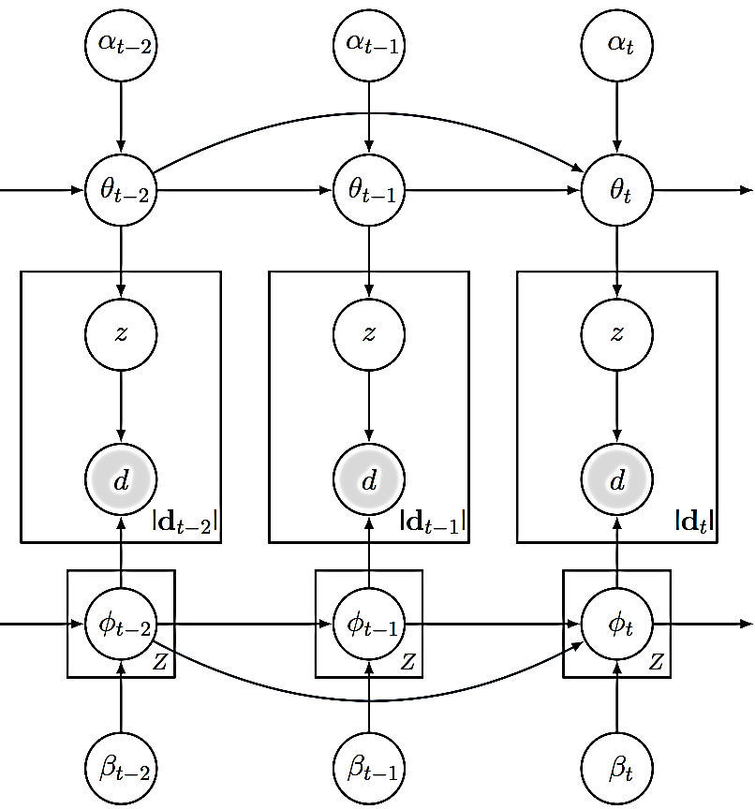




Existing Problems
Feature Relevance
Terms are meaningful by accompanied words
Relationship of terms change their topic relevance
Causes term ambiguity issue
Previous models do not consider this relevance
Enjoy Dance
Jaggery Tissue
Apple iPhone
Apple Food
$$MStreamF$$
$$TLDA$$
$$DMM$$
$$DCT$$

Slide 17
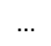
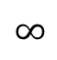
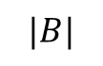
Existing Problems
Feature Relevance
Terms are meaningful by accompanied words
Relationship of terms change their topic relevance
Causes term ambiguity issue
Previous models do not consider this relevance
Online Versus Batch-wise Processing
Batch is a chunk of documents
No order sequence inside a single batch
Documents can be interchangeable inside a batch
Non-trivial task to estimate batch-size
Batch-wise processing needs processing each batch multiple time
Online processing allows to process document by document
Enjoy Dance
Jaggery Tissue
Apple iPhone
Apple Food
Data Stream
$$∞$$
$$…$$
$$|B|$$
Fixed batch size

Slide 18
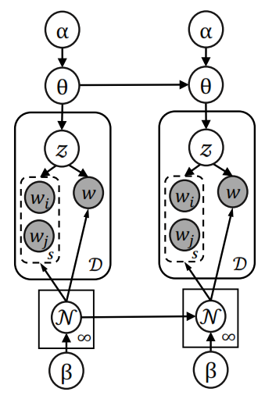
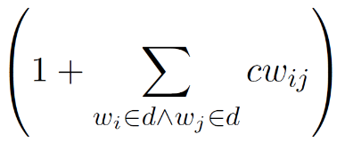
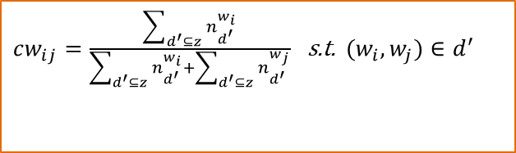
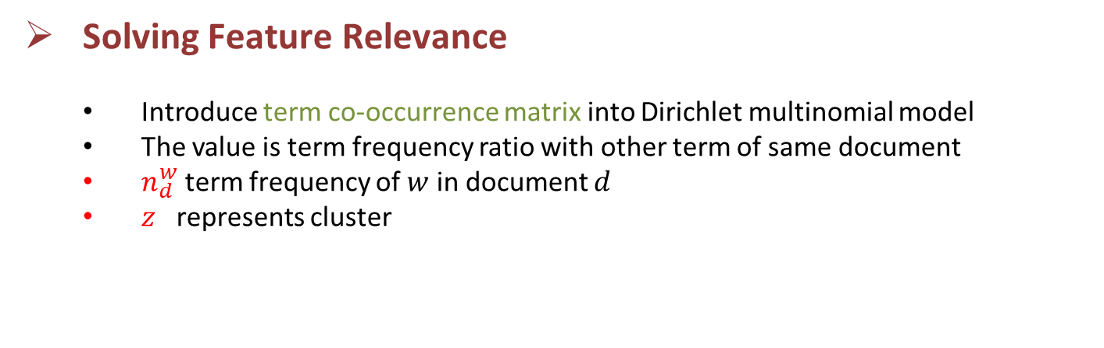
Proposed Graphic Model
Solving Feature Relevance
Introduce term co-occurrence matrix into Dirichlet multinomial model
The value is term frequency ratio with other term of same document
$n_{d}^{w}$ term frequency of $w$ in document $d$
$z$ represents cluster
Co-occurrence
$cw_{ij}=\frac{\sum_{d^{′}⊆z}{n_{d^{′}}^{w_{i}}}}{\sum_{d^{′}⊆z}{n_{d^{′}}^{w_{i}}}+\sum_{d^{′}⊆z}{n_{d^{′}}^{w_{j}}}}$ s.t. $(w_{i},w_{j})∈d^{′}$

Slide 19
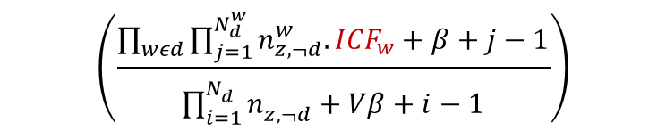
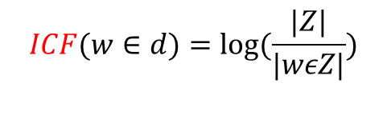
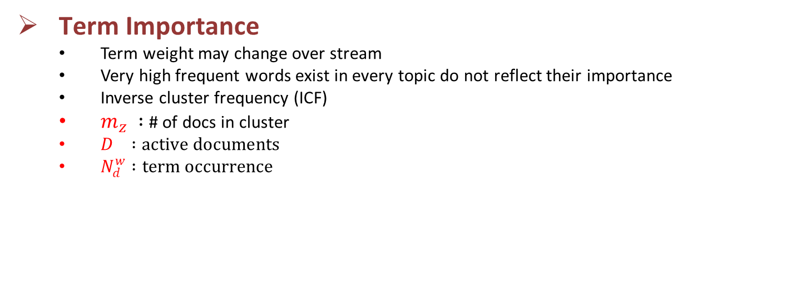

Proposed Graphic Model
Term Importance
Term weight may change over stream
Very high frequent words exist in every topic do not reflect their importance
Inverse cluster frequency (ICF)
$m_{z} :$# of docs in cluster
$D :active documents$
$N_{d}^{w} :term occurrence$
$$ICF(w∈d)=log(\frac{|Z|}{|wεZ|})$$
$$\}$$
$$\left(\frac{\prod_{wεd}{\prod_{j=1}^{N_{d}^{w}}{n_{z,¬d}^{w}.{ICF}_{w}+β+j−1}}}{\prod_{i=1}^{N_{d}^{}}{n_{z,¬d}^{}+Vβ+i−1}}\right)$$
Cluster Document Similarity

Slide 20
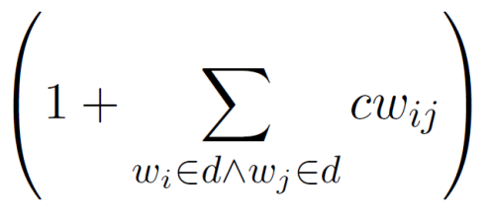
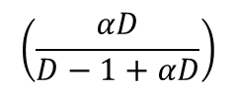
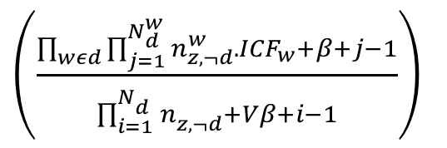
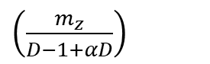
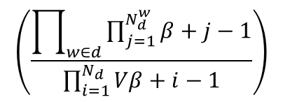
Proposed Graphic Model
Online Processing and Maintenance
Calculate two probabilities for each incoming document
If highest EC-Prob among existing cluster is lesser than NC-Prob then model create new cluster (it means a new topic may have arrived)
for creating new cluster (NC-Prob)
$$\left(\frac{αD}{D−1+αD}\right)$$
$$\left(\frac{\prod_{w∈d}{\prod_{j=1}^{N_{d}^{w}}{β+j−1}}}{\prod_{i=1}^{N_{d}}{Vβ+i−1}}\right)$$
for choosing existing cluster (EC-Prob)
$\left(\frac{\prod_{wεd}{\prod_{j=1}^{N_{d}^{w}}{n_{z,¬d}^{w}.{ICF}_{w}+β+j−1}}}{\prod_{i=1}^{N_{d}^{}}{n_{z,¬d}^{}+Vβ+i−1}}\right)$
$\left(\frac{m_{z}}{D−1+αD}\right)$

Slide 21

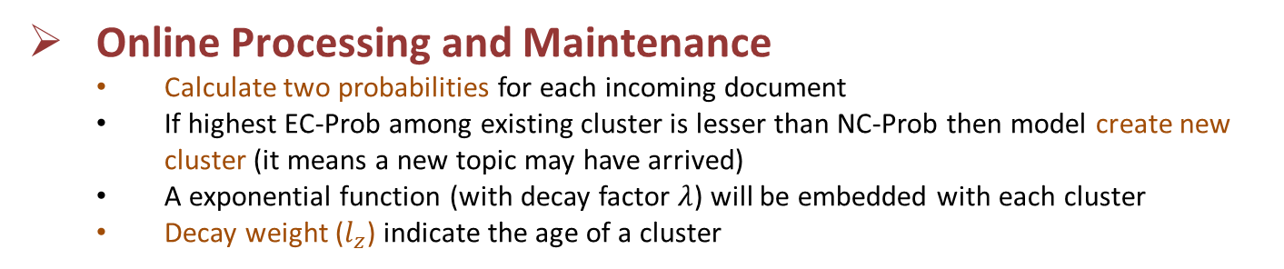
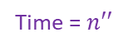
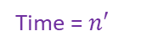
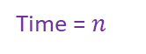
Proposed Graphic Model
Online Processing and Maintenance
Calculate two probabilities for each incoming document
If highest EC-Prob among existing cluster is lesser than NC-Prob then model create new cluster (it means a new topic may have arrived)
A exponential function (with decay factor $λ$) will be embedded with each cluster
Decay weight ($l_{z}$) indicate the age of a cluster
$$l_{z}=l_{z}×2^{−λ(△time)}$$
Time = $n$
Time = $n′$
Time = $n′′$
Topics = 3
Topics = 4
Topics = 2

Slide 22
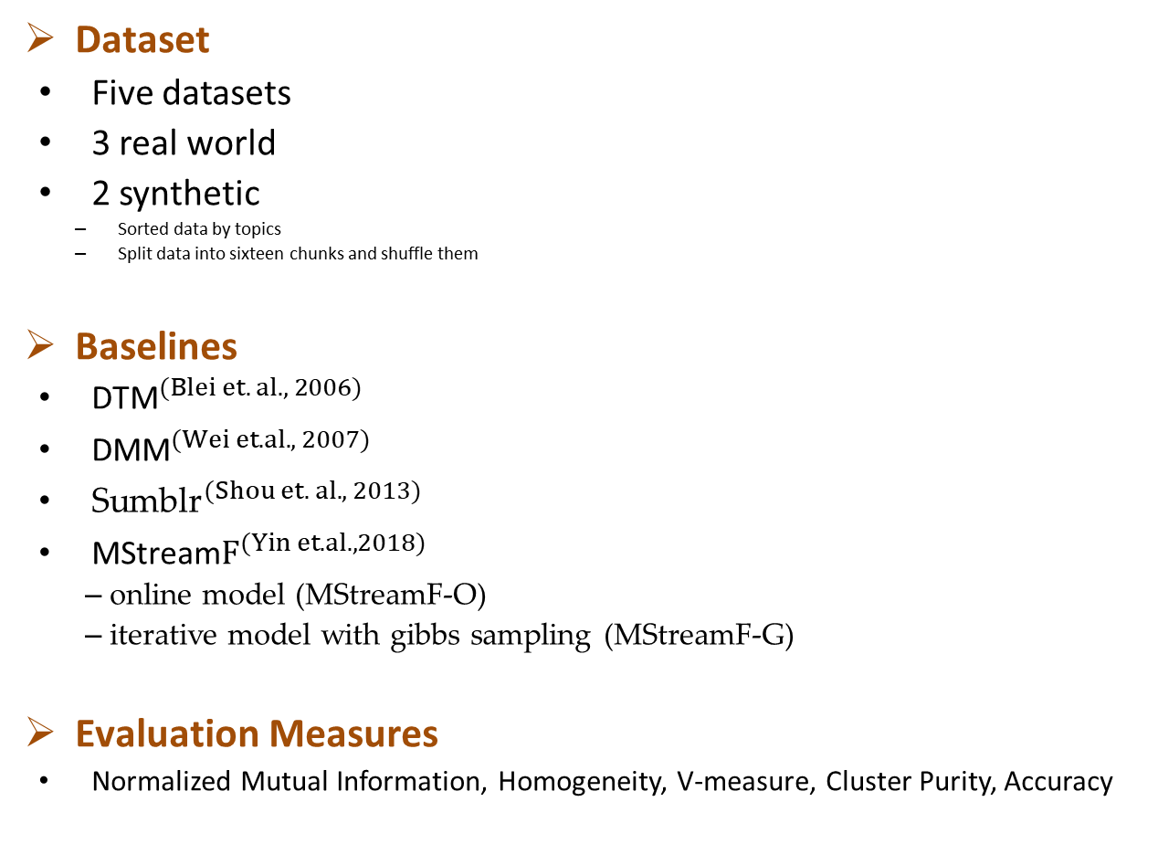
Experiments
Dataset | Docs | Vocab | Topics
News | 11,109 | 8,110 | 152
Tweets | 30,322 | 12,301 | 269
Reuters | 9,447 | 32,303 | 66
News-T | 11,109 | 8,110 | 152
Reuters-T | 9,447 | 32303 | 66
Dataset
Five datasets
3 real world
2 synthetic
Sorted data by topics
Split data into sixteen chunks and shuffle them
Baselines
${\text{DTM}}^{(Blei et. al., 2006)}$
${\text{DMM}}^{(Wei et. al., 2007)}$
${\text{Sumblr}}^{(Shou et. al. , 2013)}$
${\text{MStream}F}^{(Yin et. al., 2018)}$
online model (MStreamF-O)
iterative model with gibbs sampling (MStreamF-G)
Evaluation Measures
Normalized Mutual Information, Homogeneity, V-measure, Cluster Purity, Accuracy

Slide 23
Results
Clustering Evaluation
Highest Purity
Outperformed for real world datasets
 | Data sets | OSDM | MStreamF-O | MStreamF-G | Sumblr | DTM | DMM
NMI | News | 0.815 | 0.685 | 0.780 | 0.630 | 0.808 | 0.586
 | Tweets | 0.836 | 0.746 | 0.795 | 0.698 | 0.800 | 0.636
 | Reuters | 0.552 | 0.361 | 0.364 | 0.464 | 0.537 | 0.448
 | News-T | 0.858 | 0.803 | 0.888 | 0.723 | 0.810 | 0.582
 | Reuters-T | 0.554 | 0.381 | 0.405 | 0.494 | 0.537 | 0.476
Homo | News | 0.951 | 0.654 | 0.751 | 0.547 | 0.833 | 0.588
 | Tweets | 0.936 | 0.695 | 0.738 | 0.758 | 0.822 | 0.622
 | Reuters | 0.954 | 0.374 | 0.319 | 0.402 | 0.659 | 0.466
 | News-T | 0.900 | 0.778 | 0.900 | 0.747 | 0.837 | 0.565
 | Reuters-T | 0.964 | 0.385 | 0.343 | 0.574 | 0.657 | 0.497
V-Measure | News | 0.805 | 0.684 | 0.779 | 0.630 | 0.808 | 0.586
 | Tweets | 0.831 | 0.744 | 0.793 | 0.696 | 0.800 | 0.636
 | Reuters | 0.479 | 0.361 | 0.361 | 0.458 | 0.526 | 0.448
 | News-T | 0.857 | 0.803 | 0.888 | 0.723 | 0.810 | 0.582
 | Reuters-T | 0.478 | 0.380 | 0.400 | 0.436 | 0.527 | 0.476
Purity | News | 0.907 | 0.552 | 0.653 | 0.414 | 0.767 | 0.456
 | Tweets | 0.890 | 0.529 | 0.801 | 0.609 | 0.749 | 0.473
 | Reuters | 0.962 | 0.602 | 0.530 | 0.609 | 0.793 | 0.673
 | News-T | 0.851 | 0.636 | 0.835 | 0.580 | 0.765 | 0.398
 | Reuters-T | 0.972 | 0.608 | 0.606 | 0.770 | 0.795 | 0.694
Acc | News | 0.880 | 0.420 | 0.517 | 0.560 | 0.647 | 0.334
 | Tweets | 0.665 | 0.246 | 0.707 | 0.539 | 0.246 | 0.15
 | Reuters | 0.927 | 0.577 | 0.452 | 0.652 | 0.669 | 0.649
 | News-T | 0.769 | 0.584 | 0.606 | 0.653 | 0.294 | 0.073
 | Reuters-T | 0.952 | 0.447 | 0.461 | 0.620 | 0.644 | 0.500

Slide 24
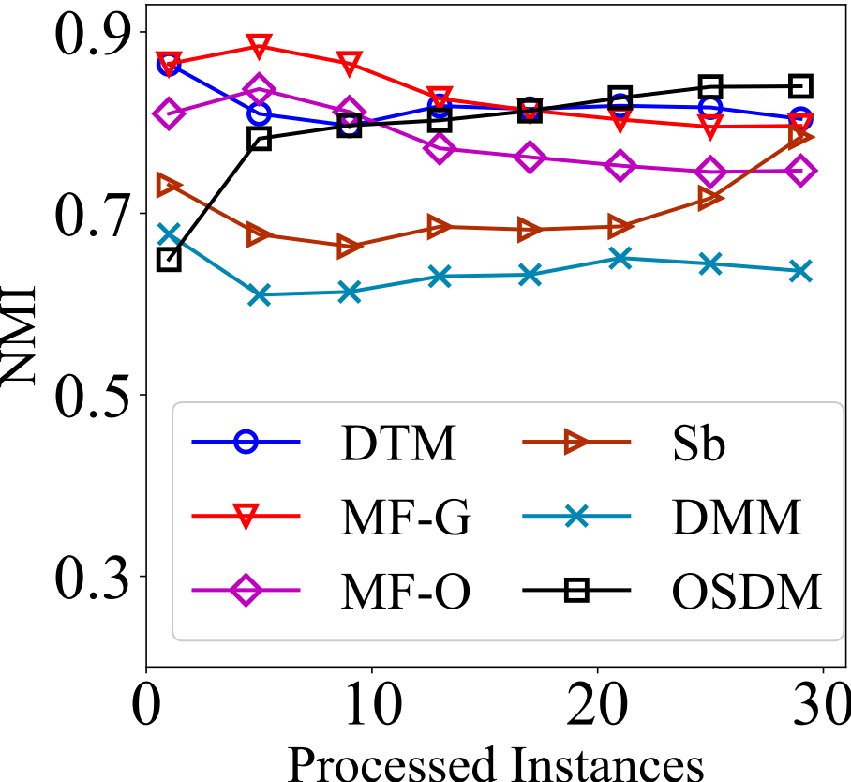
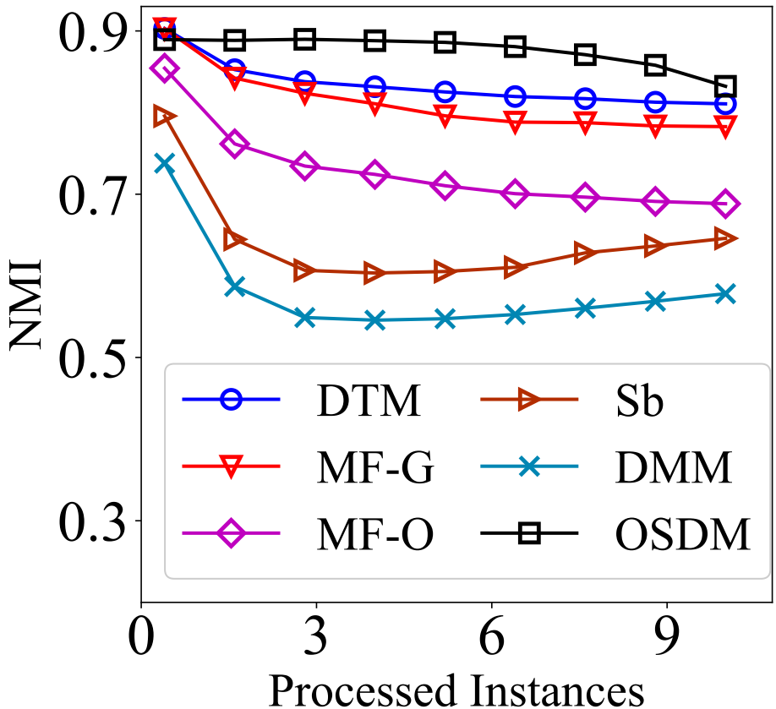
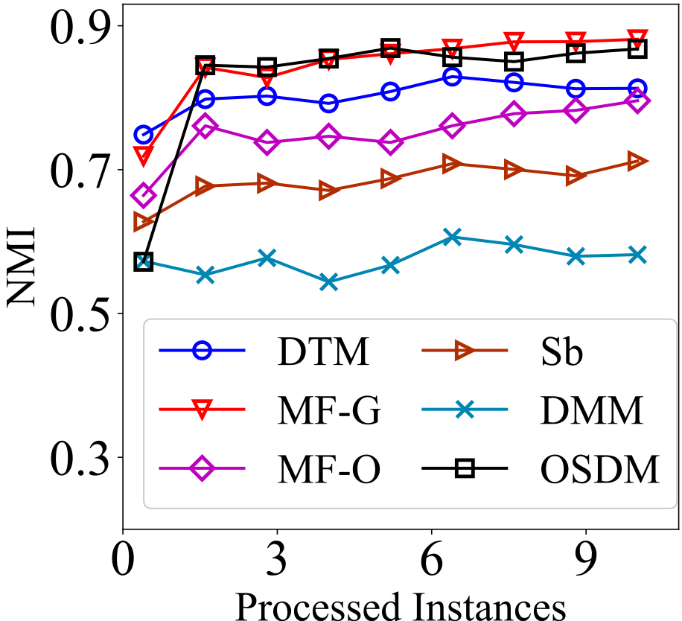
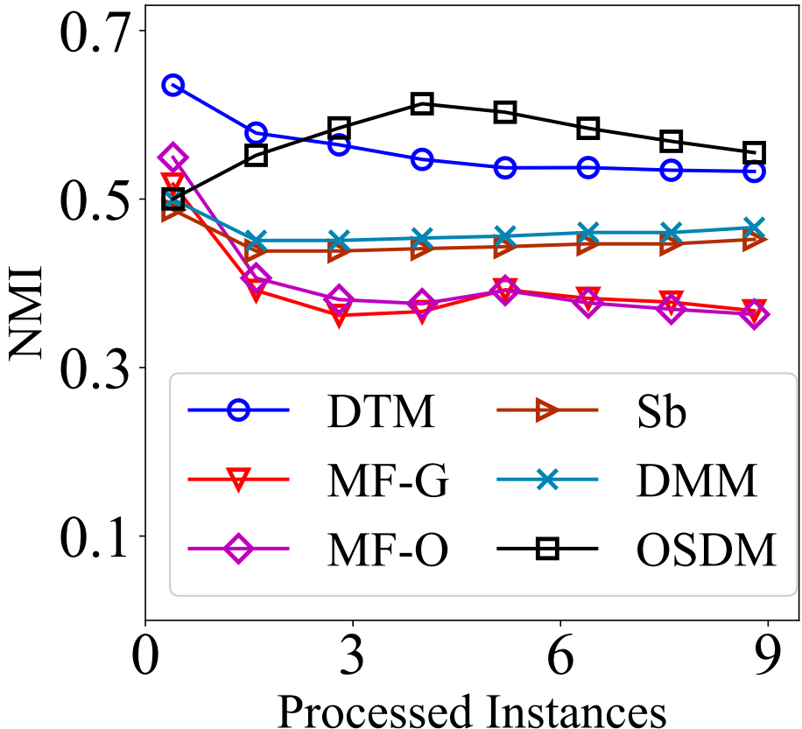
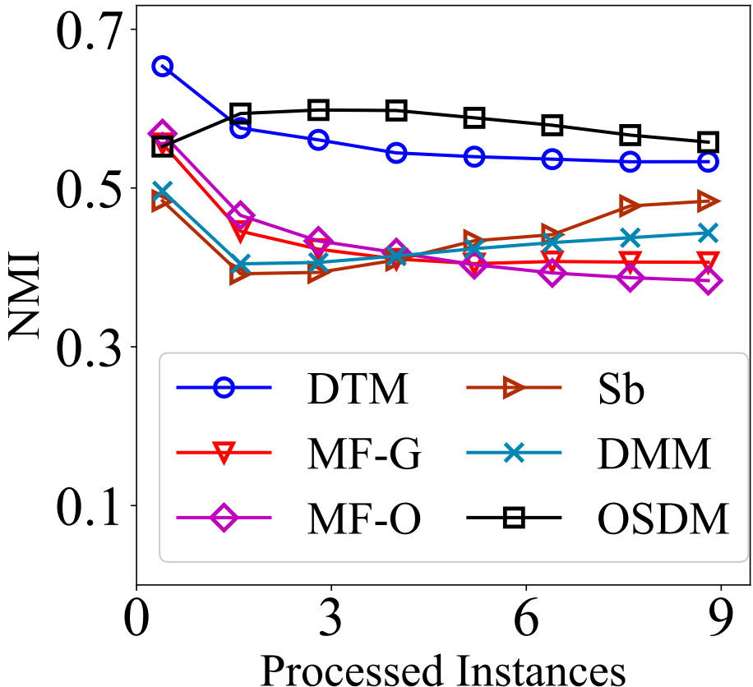
Model Performance
NMI over stream
Model needs to maintain the NMI
Less variance over stream means model is able to adapt concept evolution
OSDM reports very stable NMI over stream
Compared to all most model the performance line of OSDM is clearly high
Tweets
News
News-T
Reuters
Reuters-T

Slide 25
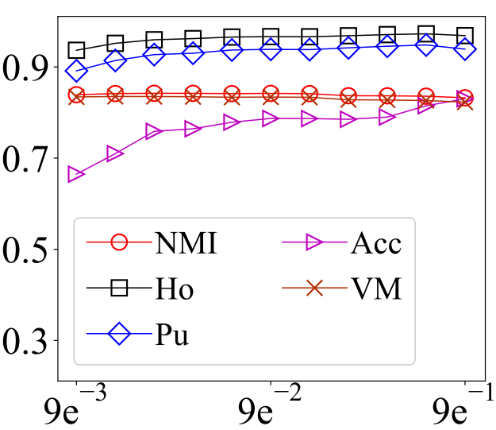
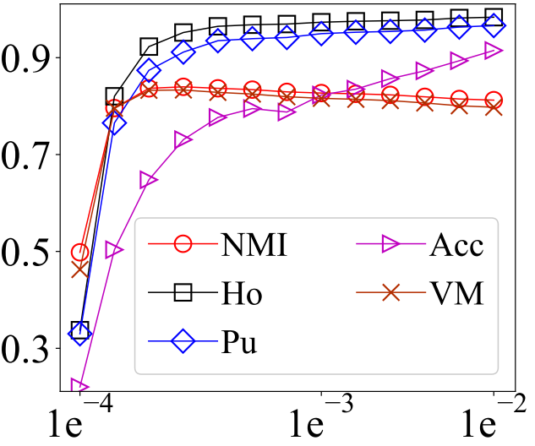
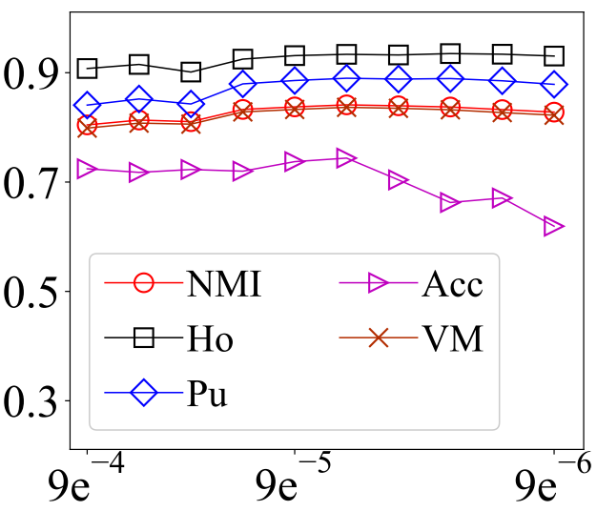
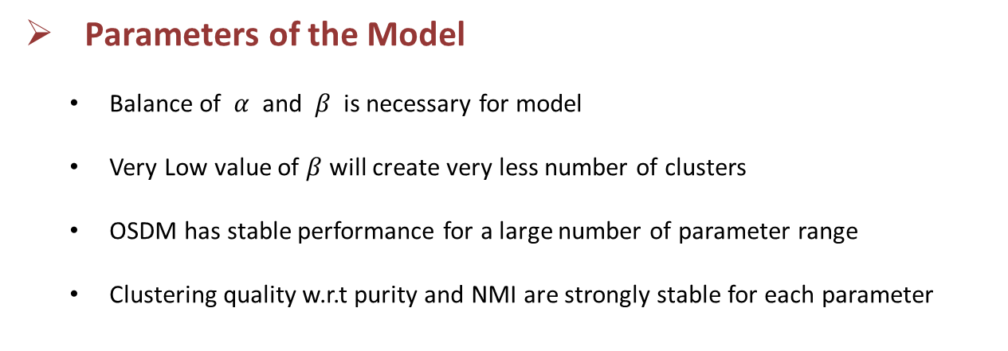
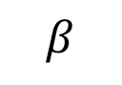

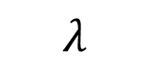
Parameter Sensitivity
Parameters of the Model
Balance of $α$ and $β$ is necessary for model
Very Low value of $β$will create very less number of clusters
OSDM has stable performance for a large number of parameter range
Clustering quality w.r.t purity and NMI are strongly stable for each parameter
$$α$$
$$β$$
$$λ$$

Slide 26
Summary
Previous clustering models do not consider semantic representation which leads to term ambiguity issue
SOTA adopt batch-wise processing and delete old batches
The proposed model solve term ambiguity issue by embedding term co-occurrence matrix
Can approximate and track evolving number of topics
Process documents in online fashion, thus no dependency on batch-size.
Proposed model removes outdated cluster using cluster level exponential weight

Slide 27
2
An Online Graphical Model for
Evolving Short Text Stream Clustering
in IEEE Transactions of Cybernetics, 2021

Slide 28
Introduction
In social text stream, a topic is revolve around core terms
A topic with non-changing core terms is referred as Event
A topic with changing core terms are dynamic in nature
To get good results it is necessary for a model to track change in core terms for each topic
Previous approaches do not consider core term evolution for online clustering
Gaga
Shakira
Performance
LosAngels
Gaga
Shakira
Performance
LosAngels
Trump
Election
Campaign
Vegas
Core Terms Change
Trump
Campanign
NewYork
Apple
Health
Benefit
Apple
Health
Benefit

Slide 29
Introduction
Decrease number of cluster in model
Number of clusters in the model should be very close to actual number of topic
Fine-grain versus Coarse-Grain Clustering
Challenges
Core Term Evolution
Model Cluster Sparsity

Slide 30



Proposed Model
Solving Core Terms Evolution
Introduce triangular time function for each cluster feature
It removes noisy and very less frequent terms
Size of single term vector and co-occurrence matrix is automatically adjected
controlled by threshold $Γ$

Slide 31





Proposed Model
Improving Probability
High variance in vocabulary size
Introduce triangular time function for each cluster feature
$V_{z}$ is average vocabulary size
$V_{z∪d}$ total vocabulary size of document and cluster instead of global vocabulary
$$\left(\frac{\prod_{w∈d}{\prod_{j=1}^{N_{d}^{w}}{β+j−1}}}{\prod_{i=1}^{N_{d}}{\overline{V_{z}}β+i−1}}\right)$$
$$\left(\frac{αD}{D−1+αD}\right)$$
.$\left(\frac{\prod_{wεd}{\prod_{j=1}^{N_{d}^{w}}{n_{z,¬d}^{w}.{ICF}_{w}+β+j−1}}}{\prod_{i=1}^{N_{d}^{}}{n_{z,¬d}^{}+V_{z∪d}β+i−1}}\right)$.
$\left(\frac{m_{z}}{D−1+αD}\right)$

Slide 32


Proposed Model
Reducing Cluster Sparsity
Introduce cluster merging process
If $l_{z}≈0$ then check if cluster can be merged with existing cluster
Un-merged cluster will be removed from the model
$λ$ controls the age of cluster
$t_{c}$ current time of the model
$u_{z}$ time of cluster last update

Slide 33


Experiments
Dataset
Four datasets
2 synthetic
Place two evolving topics together
SOTA
${\text{DTM}}^{(Blei et. al., 2006)}$
${\text{DMM}}^{(Wei et. al., 2007)}$
${GS\text{DMM}}^{(Yin et. al., 2016)}$
${\text{MStream}}^{(Yin et. al., 2018)}$
${NPMM}^{(Chen et. al., 2019)}$
${OSDM}^{(kumar et. al. , 2020)}$
Dataset | Docs | Vocab | Topics
News | 11109 | 8110 | 152
News-T | 11109 | 8110 | 147
Tweets | 30322 | 12301 | 269
Tweets-T | 30322 | 12301 | 265

Slide 34
Results
Clustering Evaluation
OSGM-ES is without including inverse cluster frequency
Proposed model gained higher clustering results
 | Datasets | OSGM | OSGM-ES | OSDM | MF-G | MF-O | DTM | NPMM-O | NPMM-G | DMM | GSDMM
NMI | News | 0.815 | 0.822 | 0.814 | 0.780 | 0.685 | 0.800 | 0.809 | 0.843 | 0.592 | 0.821
 | Tweets | 0.822 | 0.836 | 0.822 | 0.795 | 0.746 | 0.800 | 0.769 | 0.821 | 0.392 | 0.798
 | News-T | 0.854 | 0.853 | 0.854 | 0.848 | 0.833 | 0.819 | 0.779 | 0.832 | 0.589 | 0.773
 | Tweets-T | 0.854 | 0.852 | 0.842 | 0.850 | 0.823 | 0.814 | 0.774 | 0.826 | 0.565 | 0.785
V-M | News | 0.815 | 0.822 | 0.805 | 0.779 | 0.684 | 0.800 | 0.809 | 0.843 | 0.592 | 0.821
 | Tweets | 0.822 | 0.836 | 0.831 | 0.793 | 0.744 | 0.800 | 0.769 | 0.821 | 0.623 | 0.798
 | News-T | 0.854 | 0.853 | 0.854 | 0.848 | 0.833 | 0.819 | 0.779 | 0.832 | 0.589 | 0.773
 | Tweets-T | 0.854 | 0.852 | 0.842 | 0.849 | 0.822 | 0.814 | 0.774 | 0.826 | 0.565 | 0.785
Homo | News | 0.893 | 0.900 | 0.950 | 0.751 | 0.654 | 0.822 | 0.802 | 0.834 | 0.595 | 0.751
 | Tweets | 0.879 | 0.910 | 0.890 | 0.738 | 0.695 | 0.822 | 0.758 | 0.813 | 0.549 | 0.728
 | News-T | 0.919 | 0.958 | 0.901 | 0.829 | 0.810 | 0.844 | 0.805 | 0.854 | 0.578 | 0.681
 | Tweets-T | 0.912 | 0.948 | 0.916 | 0.814 | 0.780 | 0.84 | 0.766 | 0.819 | 0.546 | 0.709
Purity | News | 0.824 | 0.841 | 0.907 | 0.653 | 0.552 | 0.749 | 0.71 | 0.745 | 0.474 | 0.605
 | Tweets | 0.819 | 0.855 | 0.829 | 0.801 | 0.529 | 0.749 | 0.634 | 0.696 | 0.141 | 0.581
 | News-T | 0.878 | 0.936 | 0.868 | 0.705 | 0.669 | 0.773 | 0.706 | 0.772 | 0.424 | 0.513
 | Tweets-T | 0.869 | 0.913 | 0.864 | 0.661 | 0.628 | 0.776 | 0.645 | 0.711 | 0.410 | 0.560

Slide 35


Effect of ICF
The model without Inverse clustering frequency smoothing score gained some higher results on common parameters
However, for a wide range of parameter, model with ICF acquired very less variance
This plots shows NMI and cluster generation over wide range of $α$ parameter

Slide 36


Additional Analysis
NPMM exploit pre-trained Glove word embedding to extract weight of each term in the probabilistic model
NPMM ignore these terms while OSGM automatically capture by their statistical importance
Running time of proposed model is less then most SOTA

Slide 37

Parameters Sensitivity

Slide 38


Topic Estimation Analysis
Model needs to generate number of cluster near to actual number of topics
Comparatively the cluster generation of OSGM over stream in much closer due
merging process and tracking of evolving terms

Slide 39
Summary
Previous clustering models do not consider track evolving core terms for each topic
It results to higher number of cluster generation
Propose model embed triangular time decay function
To remove noisy terms
Retain current topic core terms
Propose model contains probability-based cluster merging process to reduce the cluster sparsity

Slide 40
Mining Medical Data For Disease Analysis

Slide 41



Introduction
AI has a tremendous potential in the health care sectors
More the data better our IA system is
Health data nature is private
Data of Rare or emerging disease is less
How to increase machine learning model accuracy without sharing data
Give me data
Hospital
Output
Database
Patterns
We cannot share
We need more data

Slide 42
Introduction
Federated Learning (FL)
A way of decentralize learning
No data is needed for sharing
Model is shared
Google Keyboard (Gboard)
Medical Data Analysis as Use-case for FL
Hospitals can train local models
Models will be aggregated in the
No need to for actual data
Give me neural model
Local Learned Models
42

Slide 43
3
Blockchain-Federated-Learning and Deep Learning Models for COVID-19 Detection Using CT Imaging
in IEEE Sensors Journal, 2021

Slide 44
Motivation
Spread of Covid-19 was rapid
Coronavirus triggers an acute respiratory infection in the lungs
Initially severe cases were detected through CT Scans Images
nucleic acid test were less accurate and lack of testing kits
Doctors needed urgent training
Each Hospital have less data / no data
Challenges
Data heterogeneity due to machine configurations
Shared model reliability
Data Privacy
?
Local Learned Models
44

Slide 45

Proposed Model
Hospital Train Local Model
Local Model is capsule Neural network
Blockchain is traces the local model and ensure reliability through smart contract
45

Slide 46

Proposed Model
Capsule Network
Split the image into segments
Learn convolutional network
46

Slide 47

Blockchain
Stores transactions (in blocks) in Decentralized way
Transaction Traceability
Store weights of models of hospitals
47

Slide 48

Data Sharing Process
48

Slide 49
Federated Learning Steps
49

Slide 50


Dataset
CT Scan Images Data Collection
3 Hospitals of Chengdu City (China)
89 Subjects
Each hospital has two CT Scan Imaging machines
50

Slide 51

Segmentation Comparison with SOTA
51

Slide 52


Performance Comparison
52

Slide 53

Performance Comparison
53

Slide 54


Performance Comparison
54

Slide 55

Blockchain Cost Analysis
55

Slide 56


Thank you!!!
DM
LESS IS MORE

Slide 57


















Stream Properties
Virtual Drift
Stream has Evolving properties
Class Emergence
Change Feature Distribution
Actual Drift
Class Fading
Data Sensors
Class Evolution
Feature Evolution

Slide 58
Text Stream Properties
Evolving properties For Text Data
Trump
Election
Vegas
Trump
Election
Vegas
Class Evolution
Feature Evolution
Apple
Health
Benefit
Apple
Health
Benefit
Apple PhoneX
Change Feature Distribution
Trump
Election
Vegas
Vegas Casino
Rob
Match
India
vs
Australia
Apple
Health
Benefit
Trump
Election
Vegas
Apple
Health
Benefit

